Slide 1
\
Request for Proposals # 1
TCU Building Bridges Grant Program
A Science, Technology, Engineering & Math (STEM) grant-funding opportunity developed in partnership with the American Indian Higher Education Consortium (AIHEC) and the National Aeronautics and Space Administration (NASA)
Workshop #1:
Community of Practice
Notes:
Welcome! We will take a few more minutes to let folks join the call. While we wait, please do put your name and TCU in the chat

Slide 2
Today’s Agenda
Welcome and Grounding
RFP– Overview
Web Navigation Demo & discussion
Breakout Session
Pre-application Review
Closing & Next Steps

Slide 3
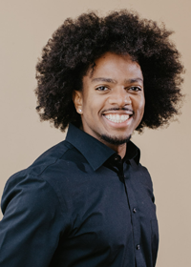
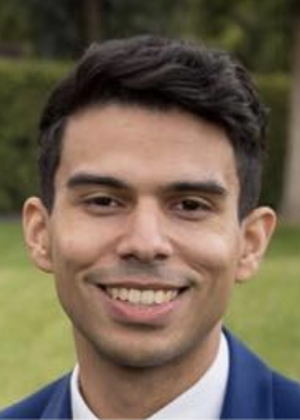
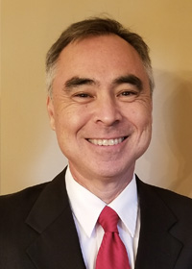
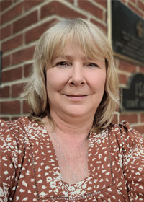
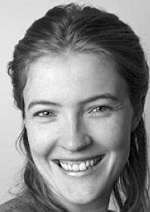
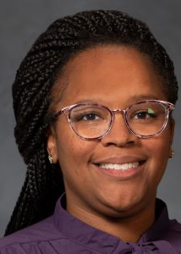
AIHEC & NASA Team

Slide 4
Timeline
& Overview
To guide the application process, four webinars and workshops will be held to provide guidance, highlight best practices, offer resources, outline expectations, and address questions.
\
Each cycle, 5 webinars will take place to support the proposal development process.
1 – Information Session + Q & A (60 Min)
2 – Workshop: Community of Practice (June 14)
3 – Workshop: Building A Competitive Proposal (June 28)
4 – Workshop: Budget Development (July 15)
5 – Office Hours (August TBD)
*Webinars will also be recorded and uploaded to AIHEC.org for review
TCU faculty and staff who are interested but are not ready to submit a project are encouraged to attend workshops and learn more about the program, then submit an application for a future cycle.

Slide 5
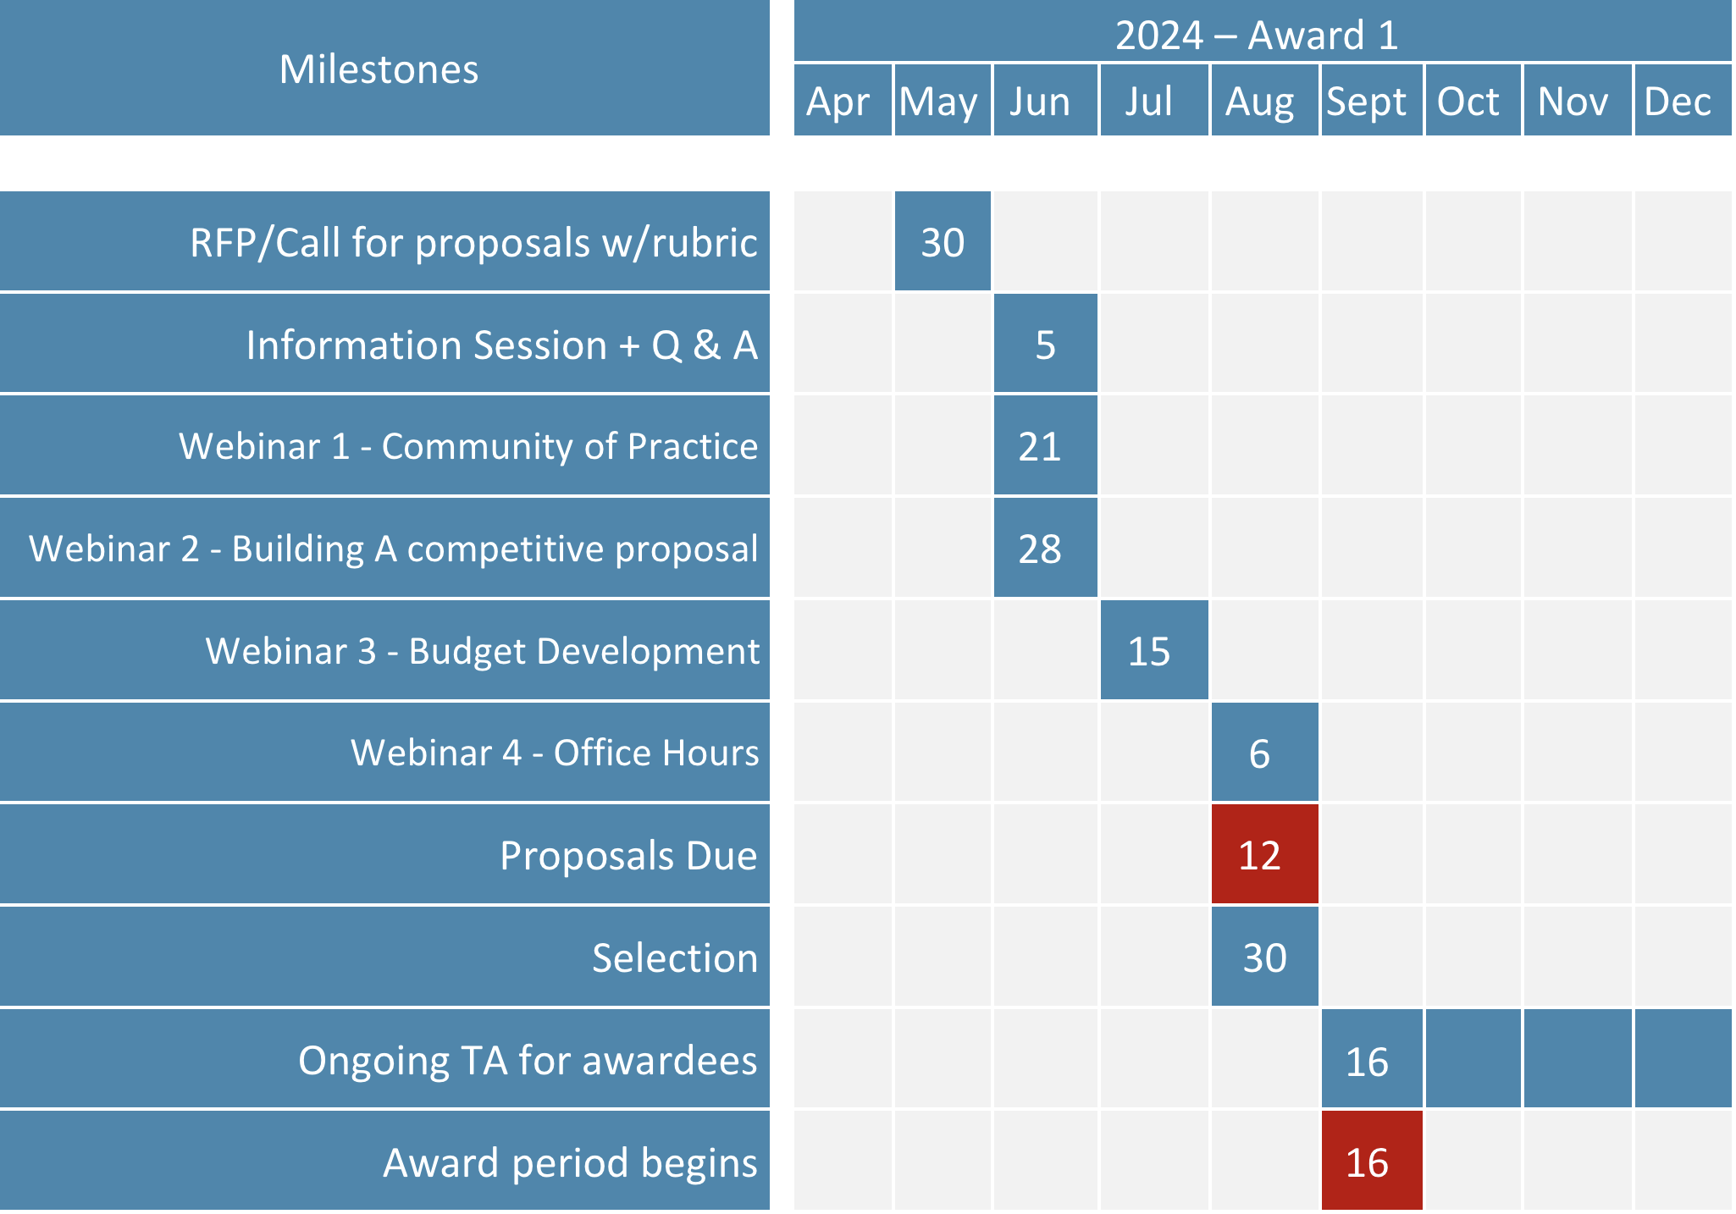
\
Timeline
& Overview
Notes:
Will be part of intro slides in future sessions

Slide 6
RFP Overview - FAQ
RFP RELEASE DATE: June 17, 2024
PROPOSAL DUE DATE: 11:59 PM Eastern Time (ET) August 12, 2024
FUNDING AMOUNT: Multiple awards of up to $68,600 are available ($686,000 total each year)
ELIGIBILITY: Funds are available to faculty led teams from all accredited Tribal Colleges & Universities
ESTIMATED CONTRACT PERIOD: September 16, 2024 through September 16, 2026, or up to 2 years (24 months) from date of award, depending on the scope of the project. Projects designed for shorter periods of time will receive equal consideration. If projects last 1 year or less, projects can be renewed for a second cycle with an additional award.

Slide 7
Web Navigation Demo –
We will look at each section of the RFP together and go over any questions that may arise
We will spend 10 minutes navigating silently on our own, and return with any questions
In small groups, take some time to:
Introduce yourselves if not already acquainted
Talk through initial impressions, thoughts, questions
Share any project ideas you have, begin the pre-application!

Slide 8
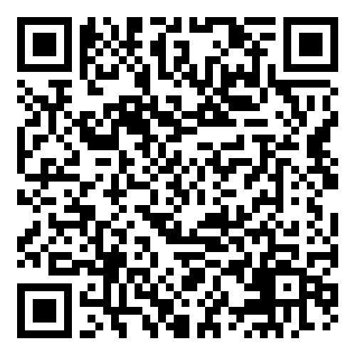
\
Thank you for coming!
Please complete our survey:
We will come back together next Friday, June 28th for a writing workshop
Notes:
https://app.smartsheet.com/b/form/d7b1cc948a424d849d977da80b65758e

